Slide 1

Mental Health
Emotional, psychological, and social well-being
Affects how we think, feel, and act
Crucial at every stage of life
- Damanveer Singh

Slide 2

“Social Media is Harming Our Mental Health”

Slide 3

Privacy issues
Rise in anxiety and depression
Disrupted sleep patterns

Slide 4
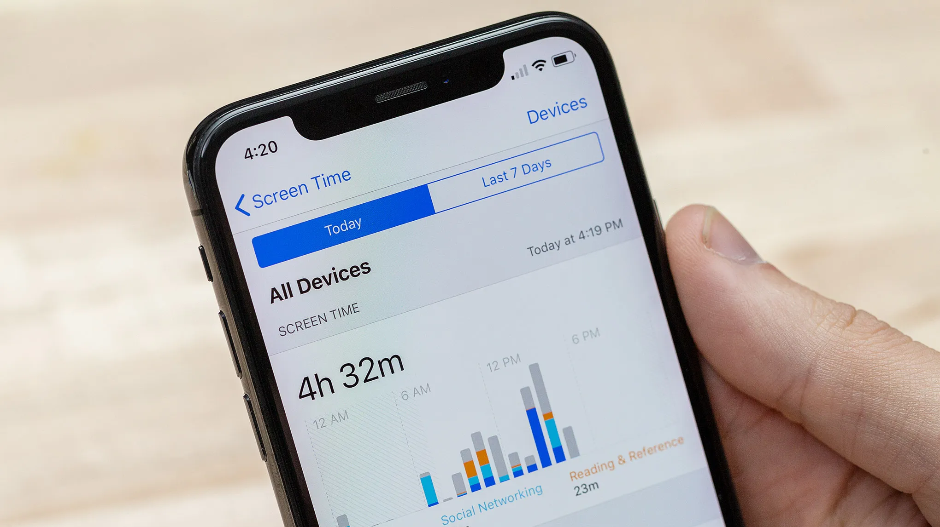
Solution !
Set screen time boundaries
Follow positive content
Take regular digital breaks

Slide 5

Screen Time Management -Set Daily Limits -Designate “Phone-Free” Hours -Use Tracking Apps

Slide 6

Mindful Content Consumption
-Follow Positive Accounts -Mute or Unfollow Toxic Pages -Engage Intentionally

Slide 7


Digital Detox & Real-Life Activities
Take Regular Breaks
Replace Screen Time with Hobbies
Reconnect Offline

Slide 8

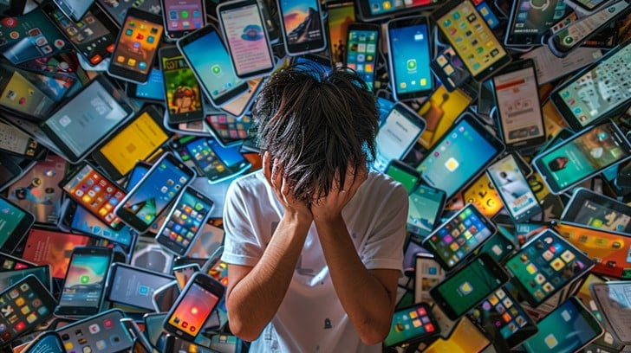
Take small steps
Notice
Notice the Effects
Use
Use It Less
Take
Take Control

